Slide 1
Restaurant Finder Chat-Bot
Cloud Computing Project
Janeil Atul Patel (jap813)
Bhushan Manohar Newalkar (bmn258)
Rana Salman Rashid (rsr348)
Divyanshu Singh (ds5387)

Slide 2
Description:
An intelligent restaurant finder chat bot, which will help users to find nearby restaurants based on their choices, preferences and affinity.
This chatbot asks a set of predefined questions to user, and based on the answers it generates a query for yelp API and the result is passed as an SMS to the user.
The web app also has an informative dashboard that displays the list of most popular restaurants on yelp, chat bots most frequently suggested restaurants as well as the user’s suggestion history (restaurants suggested to this user by chat-bot).

Slide 3

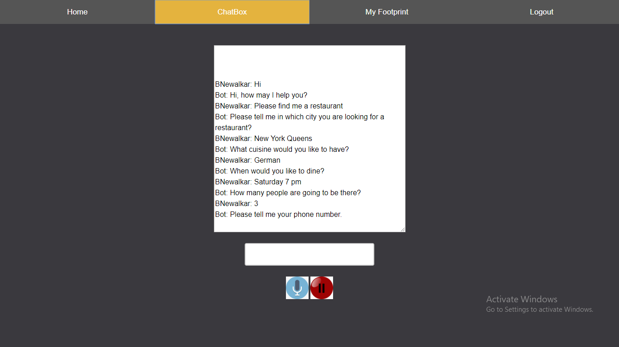
Web Application UI (Chat Window)
This is the first page where user will be re-directed as he/she logs in
This is where user will interact with the chatbot and ask for restaurant suggestions
User can use the voice input functionality provided to interact with the chat-bot

Slide 4
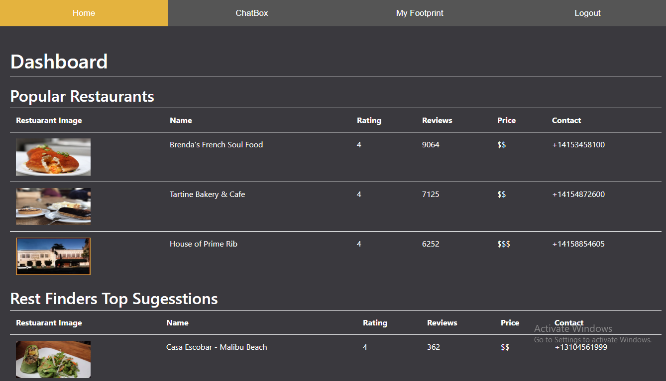
Web Application UI (Dashboard)
This page displays:
Top trending/popular restaurants on YELP
Most frequently suggested restaurants by the chat-bot application
Restaurants suggested to the user in the past

Slide 5
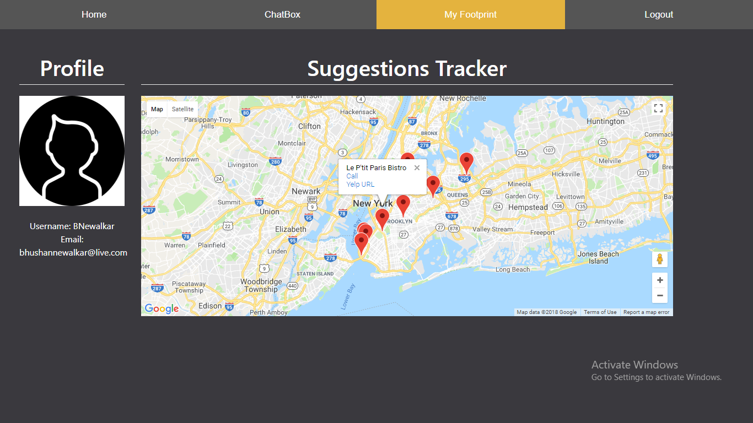
Web Application UI (Footprint)
This is the profile page where user can see his information
Also there is a map where user can find all the restaurants that were suggested to him in the past

Slide 6
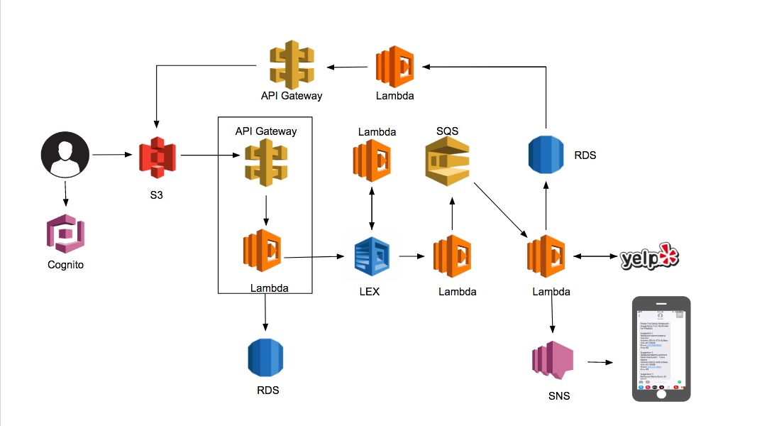
Architecture

Slide 7
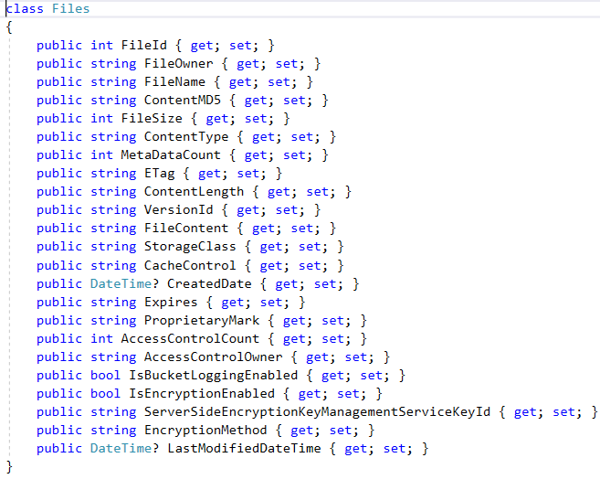
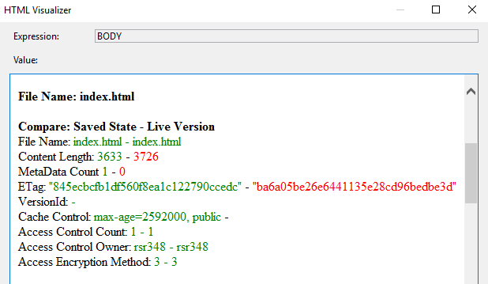
Security
Save the state of the files hosted on web hosting directory
Lambda function (C#) compares save state with current state and notifies admin incase of any malicious activity

Slide 8


